Slide 1
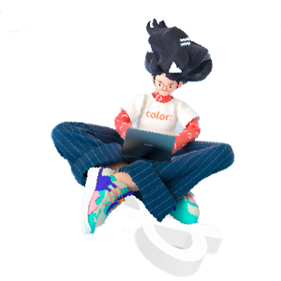
Cloud Computing Applications Graduation Project
Project Name: Water Potability Classifier using ModelArts
Team Name: AI Team ( Omnia Elmenshawy, Rayyan Alhaj, Hashem Alshami)
University: Bahçeşehir University
Email/Phone: mohamed.elmenshawy@bahcesehir.edu.tr , ahmad.alhaj@bahcesehir.edu.tr , ali.alshami1@bahcesehir.edu.tr

Slide 2
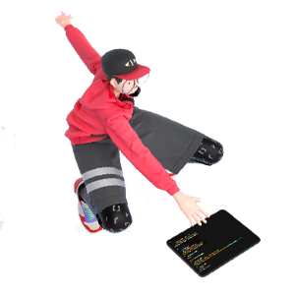

Project Overview
Overview
Project Name | Water Potability Classifier using ModelArts
Team Name | AI Team
Contacts | mohamed.elmenshawy@bahcesehir.edu.tr, ahmad.alhaj@bahcesehir.edu.tr, ali.alshami1@bahcesehir.edu.tr
Technical Field | Artificial Intelligence
Technologies | Model Arts, ExeML, OBS, Python, Jupyter Lab Notebooks, Plotly
Keywords | Classification, Water, AI
Applicable Fields | Sustainability, Sanitation, Health, Clean Water
Description (in 500 words) | Clean water is an essential element for quality life, as it is the 6th goal of the UN 17 Sustainable development goals. Our aim in this Project is to automate the process of classifying the potability of water and discover whether it is safe for human consumption or not using an artificial intelligence classifier. In order to implement our intelligence classifier we have used Model Arts service from Huawei Cloud platform and trained an ExeML model on a data from Kaggle platform that aims to classify water based on number of features in the tested water which are: The Water Ph level, hardness, solids, chloramines, sulphate, conductivity, organic carbon level, trihalomethanes, and Turbidity. As the dataset is unbalanced, we handled it using python, and we are analysing the dataset we have discovered that some data samples are considered potable while they are actually not safe for human consumption based on the WHO statistics. Since some countries lacks potable water and deliver high level of toxic water to be consumed by humans, implementing our AI Model before delivering the water is supposed to help in this scenario. Describe the usage scenarios, pain points solved, and innovations of your project.

Slide 3
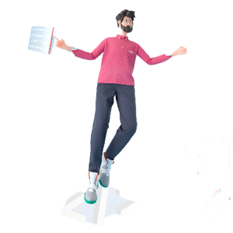
Contents
1
Team Introduction
2
Project Introduction
3
Technical Architecture
4
Functions
5
Innovations
6
Business Value
7
Project Planning
8
Achievements

Slide 4
Team Introduction
Our Team consist of 3 students from the artificial intelligence engineering department in Bahcesehir University, we have divided our tasks as follows:
1) Hashem Alshami– 4th year student: Gathering the Dataset and implementing the OBS operations on the Huawei Cloud platform, Hashem also contributed reading published researches about safe water to get more understanding of the statistical issues.
2) Omnia Elmenshawy – 4th year student: Training the model Using Model Arts Service and ExeML model, Omnia also contributed in the data analysis part and figuring out business solutions.
3) Rayyan Alhaj – 3rd year student: Deploying the trained model using the real-time deployment service, Rayyan also contributed in the authentication process of the Project.

Slide 5
Project Introduction
Predicting weather water is safe for human consumption or not could help save lives as delivering unsafe water causes toxic death worldwide and spreads diseases everywhere as shown in the World Health Organization Statistics, This is why safe water is one of the most important goals of having a sustainable life on earth.
Our project aims to classify the potability of the water based on the elements existing on the water samples collected in the dataset.
Our target column is called “Potability”, and the 0 class indicates unsafe water, while 1 class indicates Safe water.
Our Target Groups are Water companies and Governments.
Scenarios of using this project are as follows:
- identifying the toxicity level of water before human consumption.
- Reducing the diseases caused by unsafe water.

Slide 6
Technical Architecture
Explatory data analysis (EDA) : using Python libraries such as Pandas, Plotly, Numpy and Seaborn, it was implemented in the Huawei cloud Jupyter notebook IDE.
Data preprocessing : using Sklearn python library we aimed to make the data quality better by imputing the null values and balance the dataset using scikit-learn python library in order to get better results from the ModerArts machine learning service oh Huawei cloud.
Uploading the dataset to the OBS : we started by creating a bucket in the Object Storage Service of Huawei cloud using a Singapore AP location and we uploaded our preprocessed dataset in a specific folder inside of the bucket.
ModelArts: we have trained an ExeML model on our dataset giving it 10 attributes including one numerical discrete attribute as a target value in the name of potability.
Model deployment : The model has been deployed using the real time deployment service on a Huawei AI application.
Token authentication : we have authenticated our project deployment using python language

Slide 7
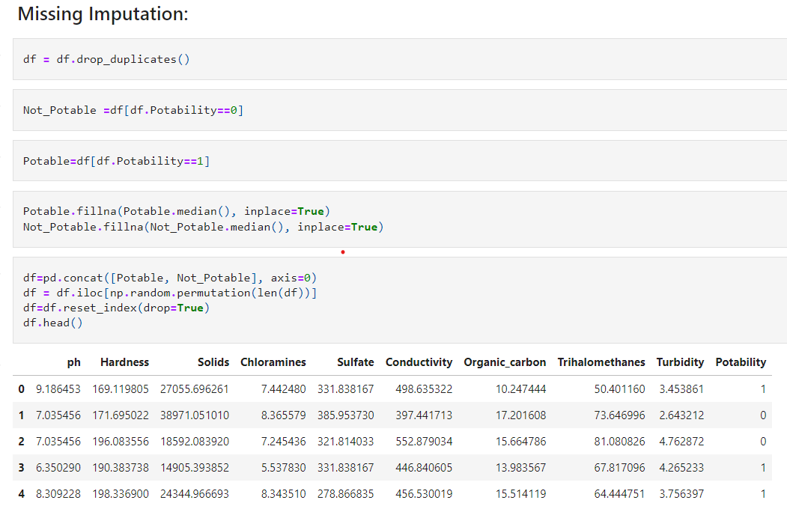
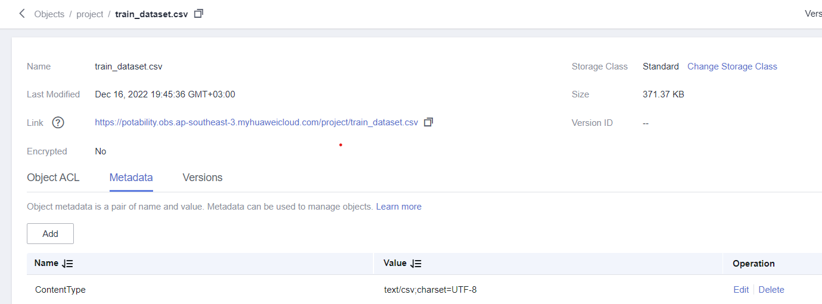
Functions
Here we are visualizing our 4 core functions:
1) Data Preprocessing using Python on Huawei Cloud Jupyter IDE:
2) Creating a Bucket and uploading the dataset using Huawei OBS:

Slide 8
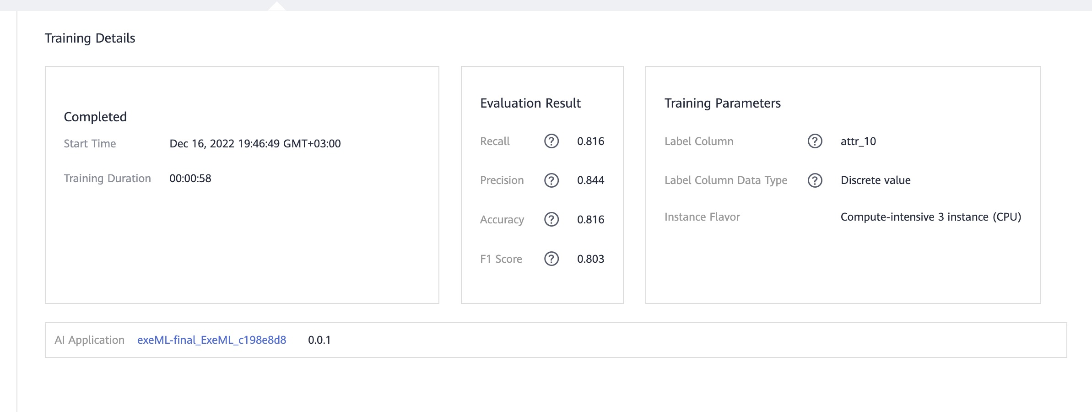
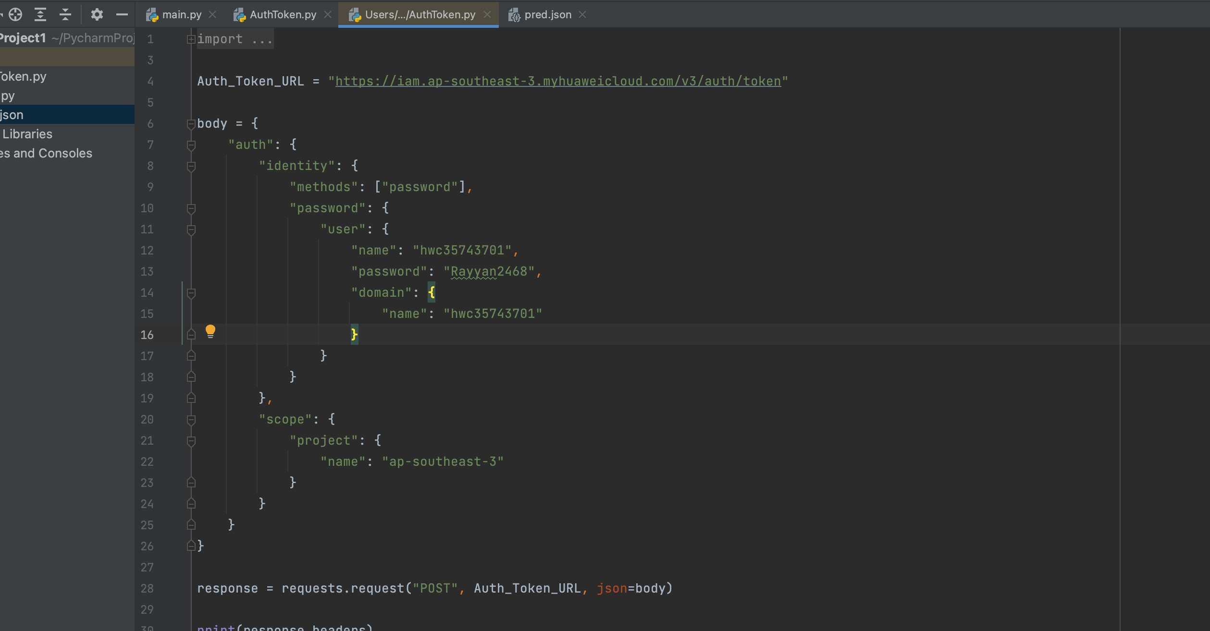
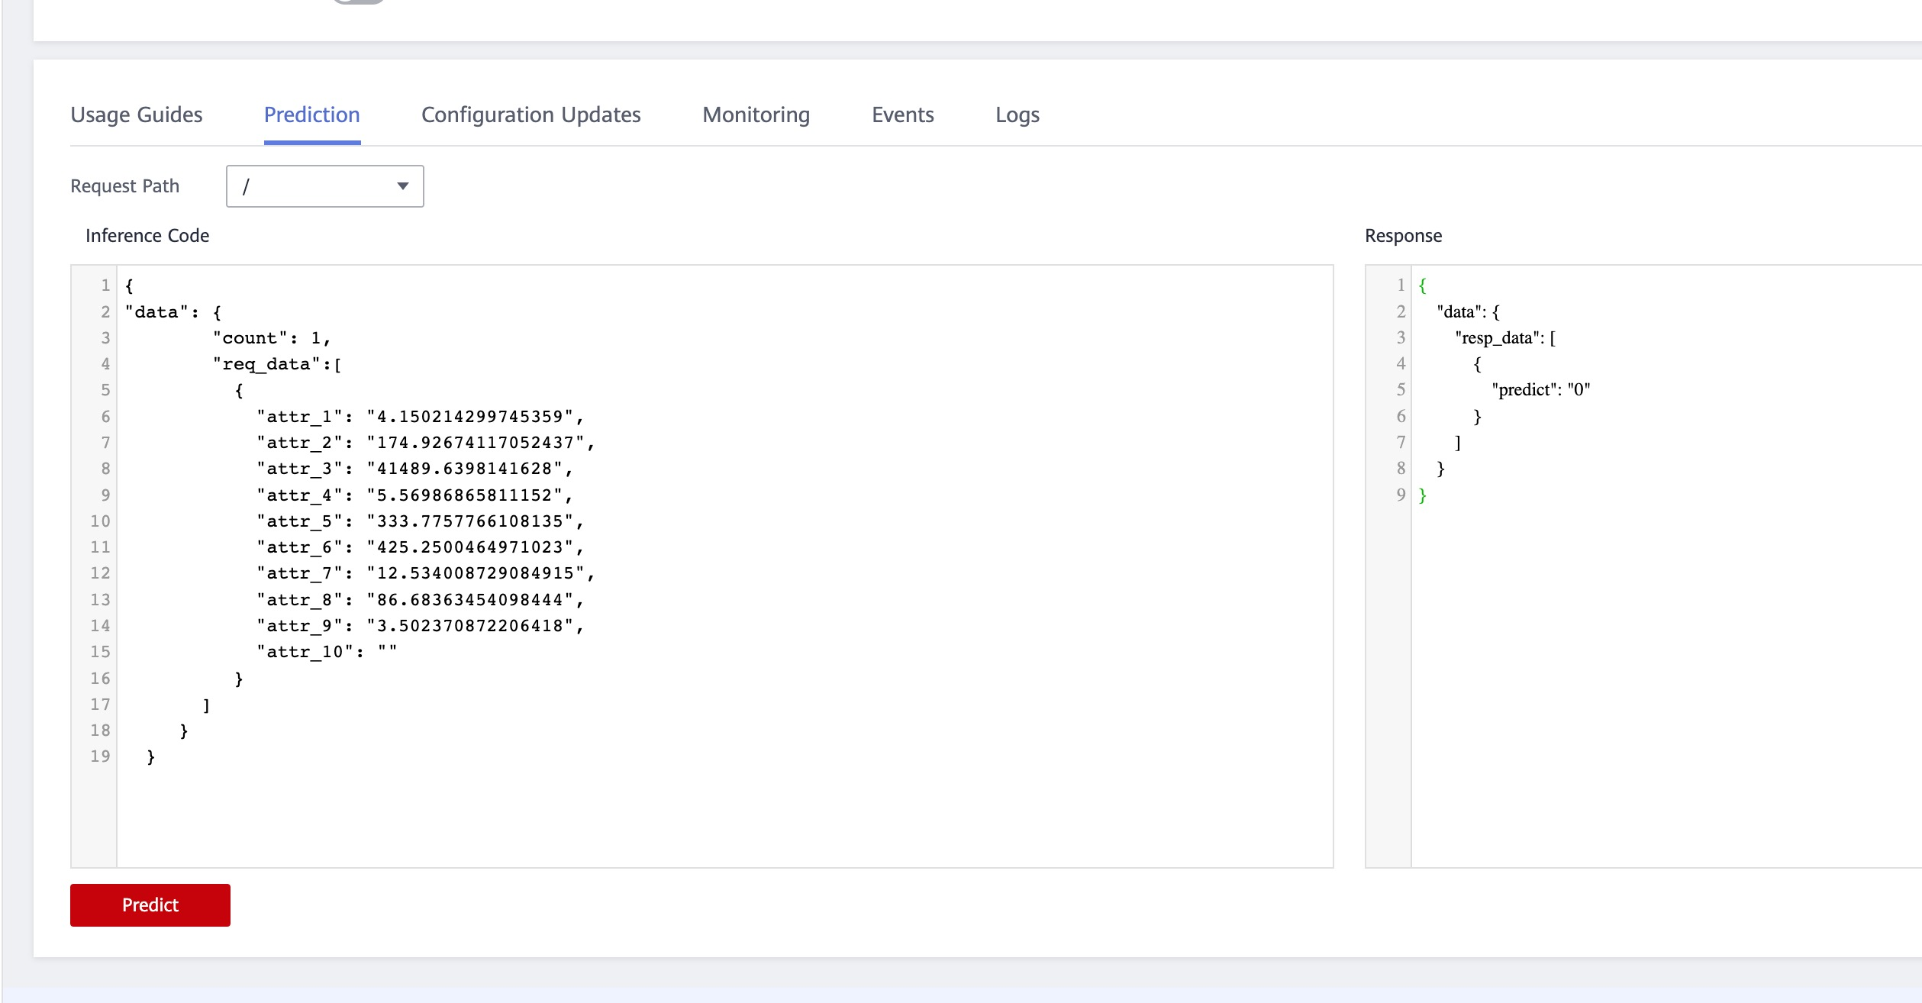
Functions
Here we are visualizing our 4 core functions:
3) Using Model Arts to train Our ExeML model and deploy it:
4) Token Authentication using Python:

Slide 9
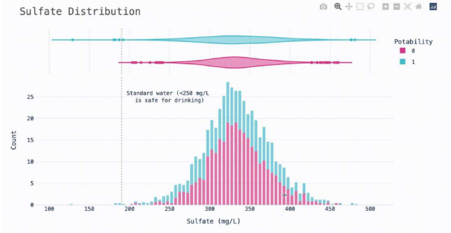
Innovations
After performing our data analysis and visualizations we discovered that some samples are miss classified in the original data such as the Sulphate level in the water ( also one of the columns) should not exceed 250 mg per litre in the water to be considered safe for human consumption as the WHO statistical guideline states, however, our data visualization shows that about 95% of the water samples exceeded that 250 mg/L limit and still classified as potable water and delivered to people for consumption And this is an important business problem that needs to be considered while classifying the water samples.
So, we suggest that implementing an AI water classifier should be implemented after applying the WHO guidelines on the collected dataset to ensure the potability of the data first.
This problem can also be found in the Hardness feature of the water, and based on our research, people in North America complains about water being hard and full of solids delivered to their homes, and here our innovative scenario could be applied.

Slide 10
Business Value
Water could be classified as potable without being really safe, which is dangerous for human use as we visualized each feature with its recommended limits.
Some countries and places might receive drinkable water without filtering it while they should filter it and take a closer look to each feature which may affect the water health so that no harm could be done to the water users.
Considering this data as a global water sample lets us understand that unpotable water exists more than the potable one, and that we should consider more sustainable ways to filter out our water instead of using fossil fuels.
also, people should be more aware of consuming plastics, as plastic ends in water and decays to microplastics which effects the water carbon levels and lasts between 450 and 1,000 years.
Implementing an AI model to classify water potabilty is not only saving time, but also saving lives and helping the ecosystem stays as sustainable as possible, Thus Governments and water companies could benefit from our Huawei cloud implemented project.

Slide 11
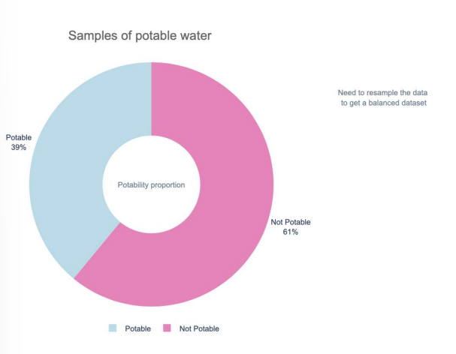
Project Planning
The project has been done in three stages
Stage one (data collection and research) : After choosing the idea of the project, it took us around five days to research and understand each feature of the data. Our understanding source is based on the world health organization water statistics and the world bank
Stage two (Data analysis and preprocessing): it took us 4 days to analyse the data statistically, figure out the misclassified water sample and to preprocess the dataset as the target column was highly unbalanced. The code was implemented on jupyter notebook IDE on Huawei cloud platform.
Stage three(ModelArts): it took us around 8 days to train an ExeML model on our dataset and deploying it using the Real Time deployment Service as well as the token authentication.

Slide 12
Achievements
We have implemented a real time machine learning classifier that takes total of 9 features as inputs, and then classify the safety of the water based on its elements.
The input features are: Water Ph level, hardness, solids, chloramines, sulphate, conductivity, organic carbon level, trihalomethanes, and Turbidity.
The Output feature is: Potability as 0 if water is not safe and 1 if water is not safe.

Slide 13
THANK YOU

